Slide 1
SYMMETRIC KEY DISTRIBUTION USING SYMMETRIC ENCRYPTION
Reference: William Stallings

Slide 2
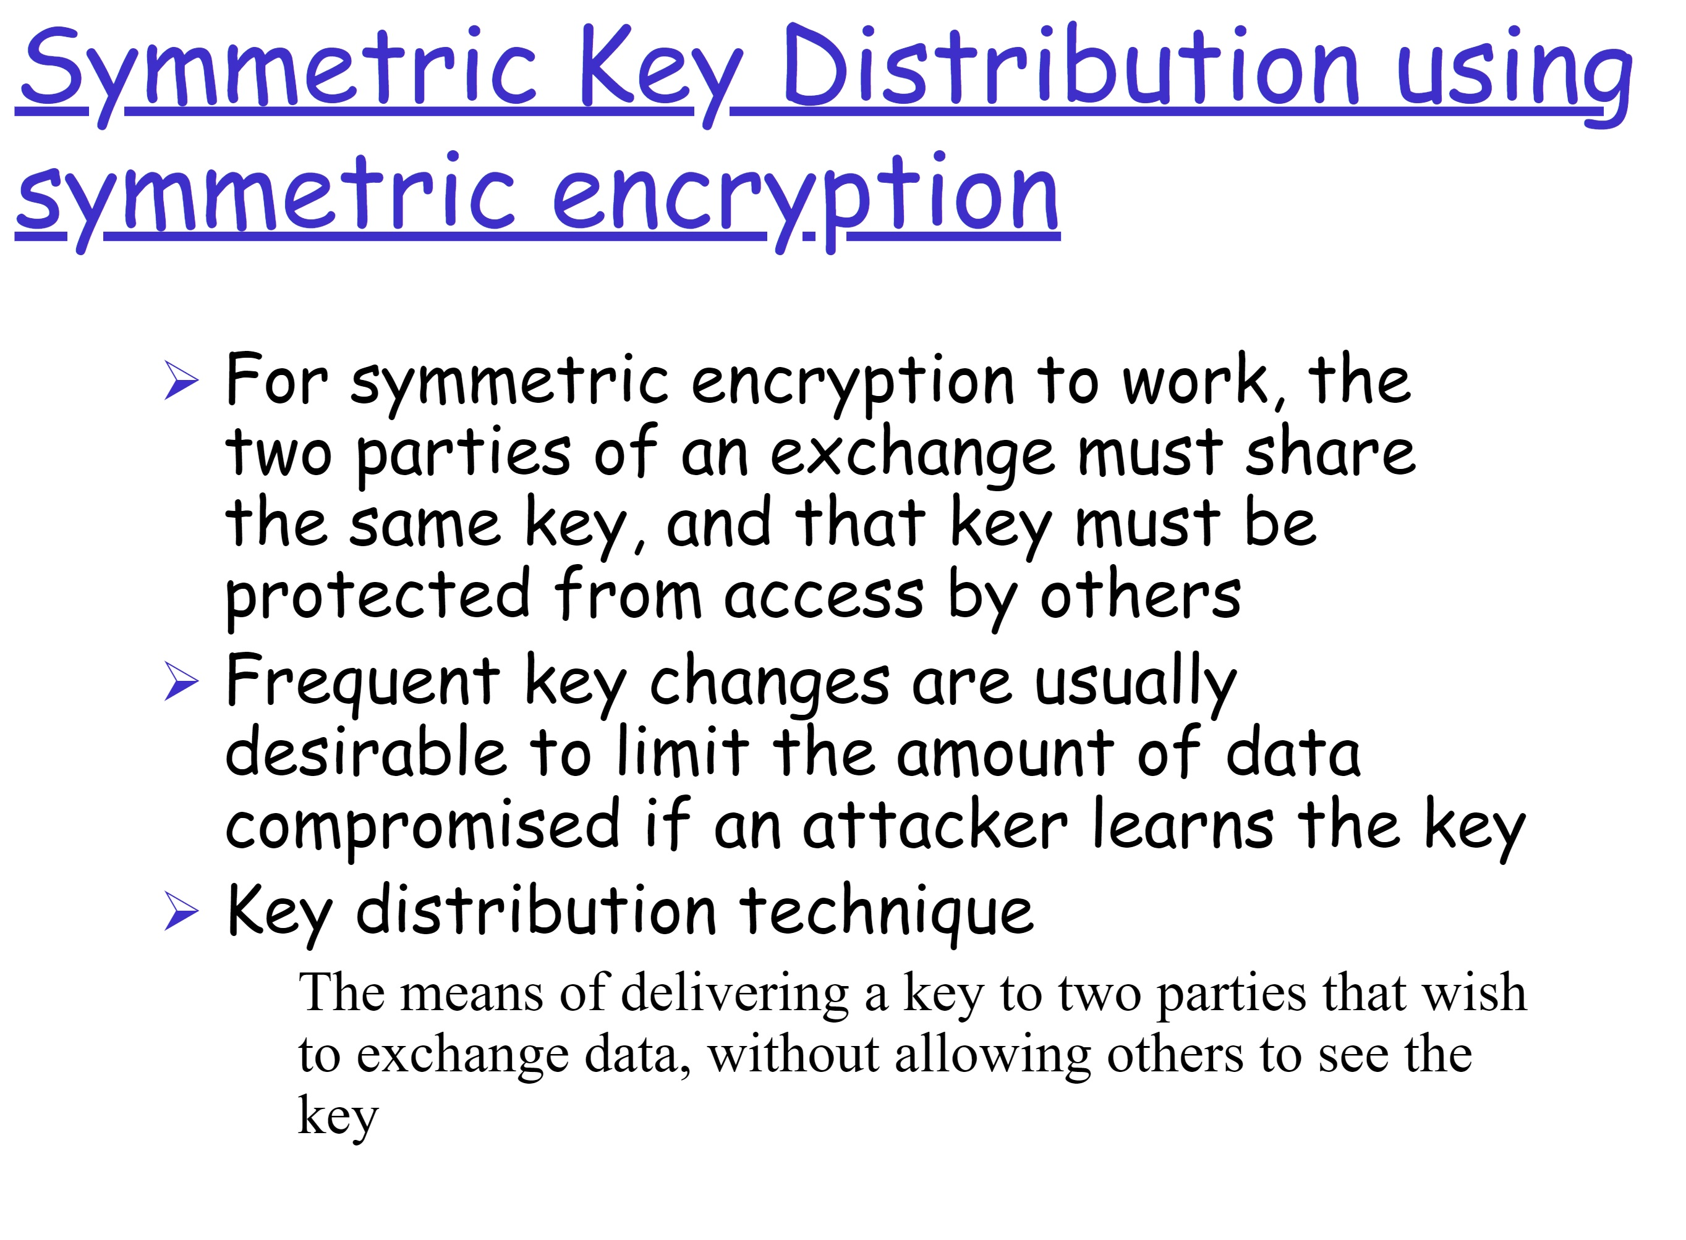

Slide 3
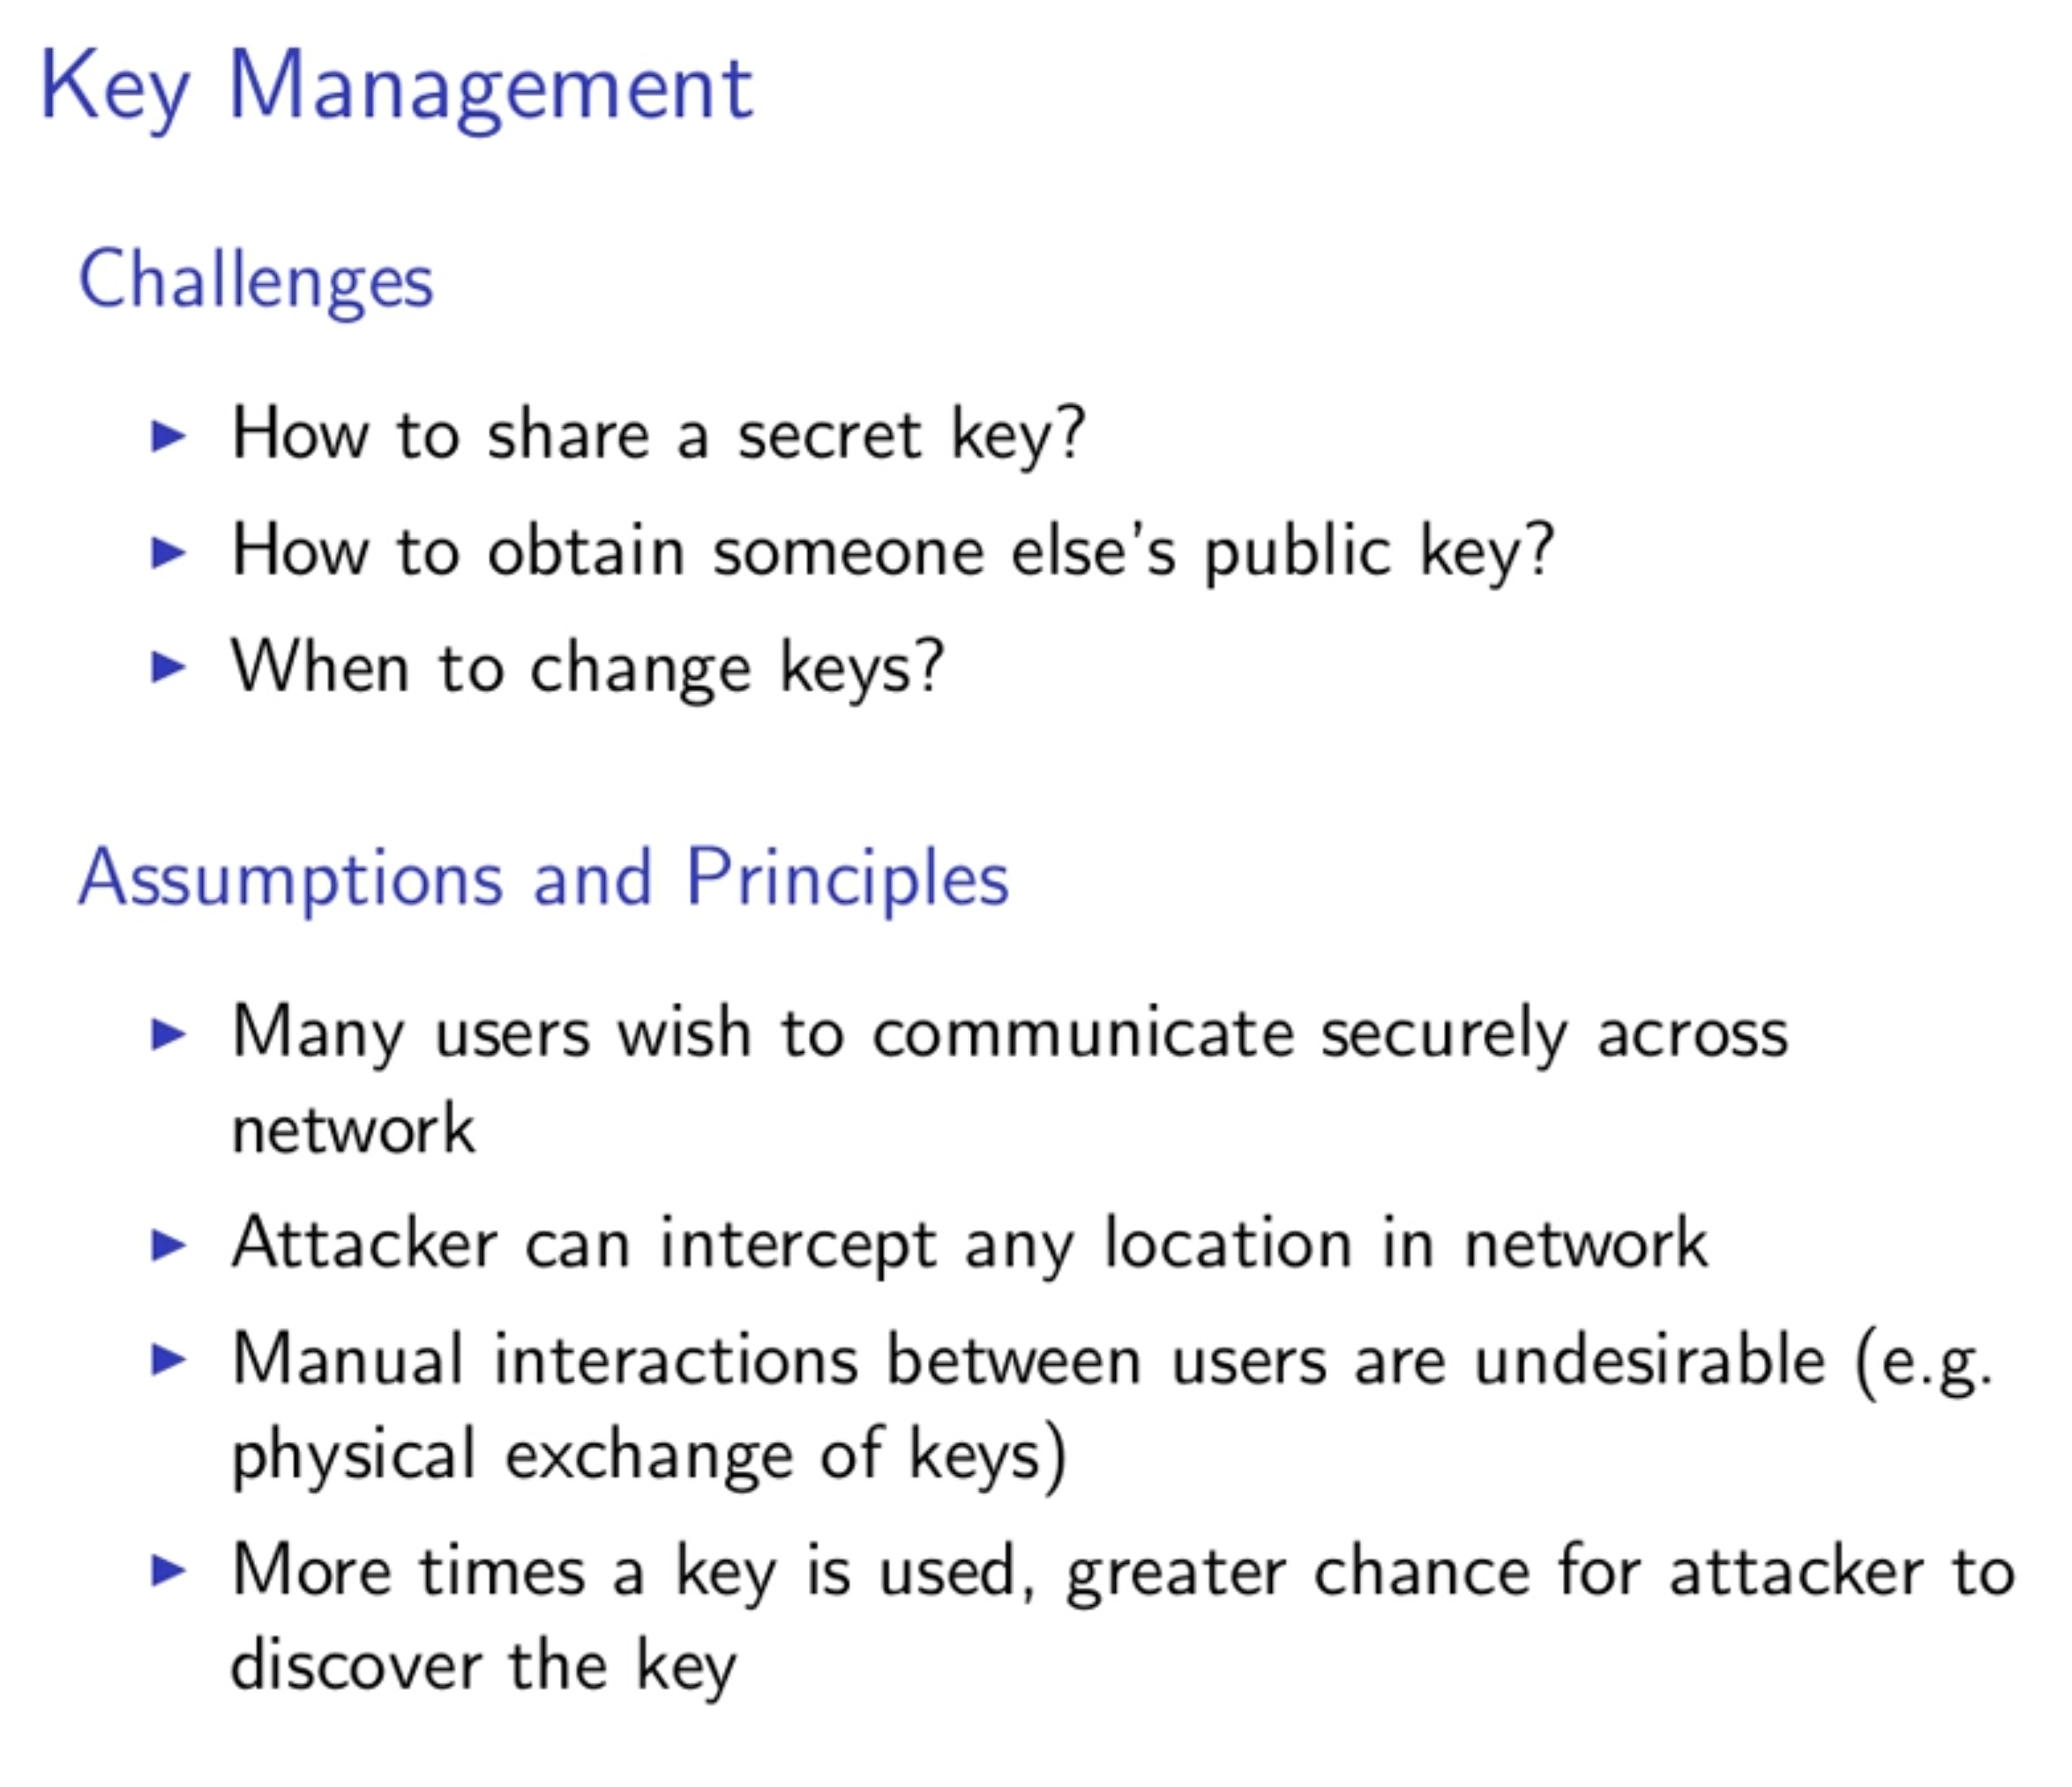

Slide 4
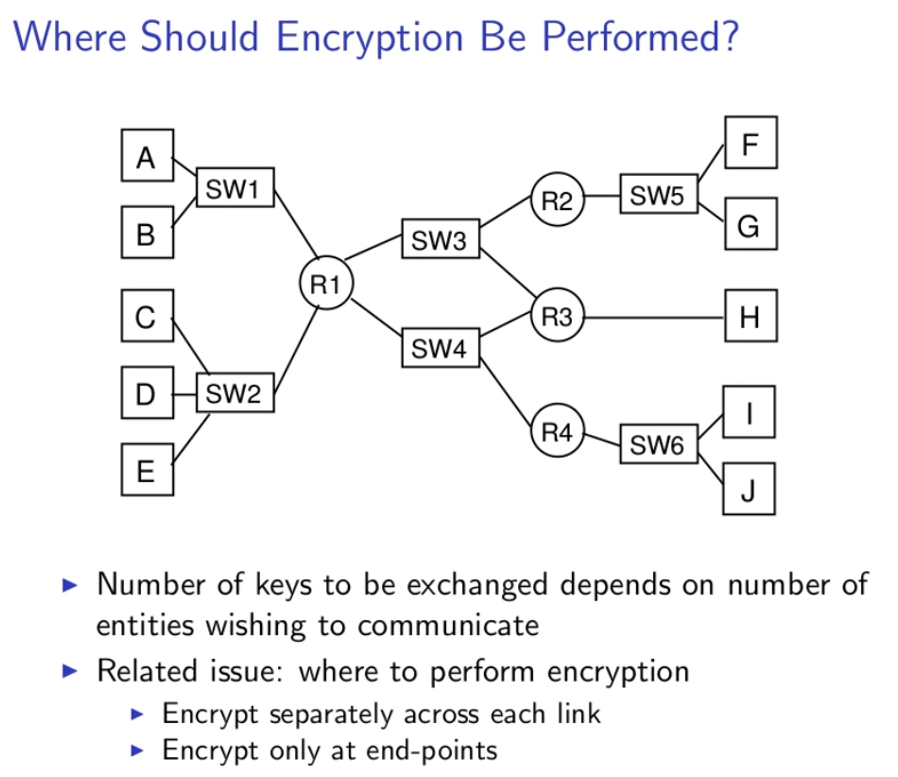

Slide 5
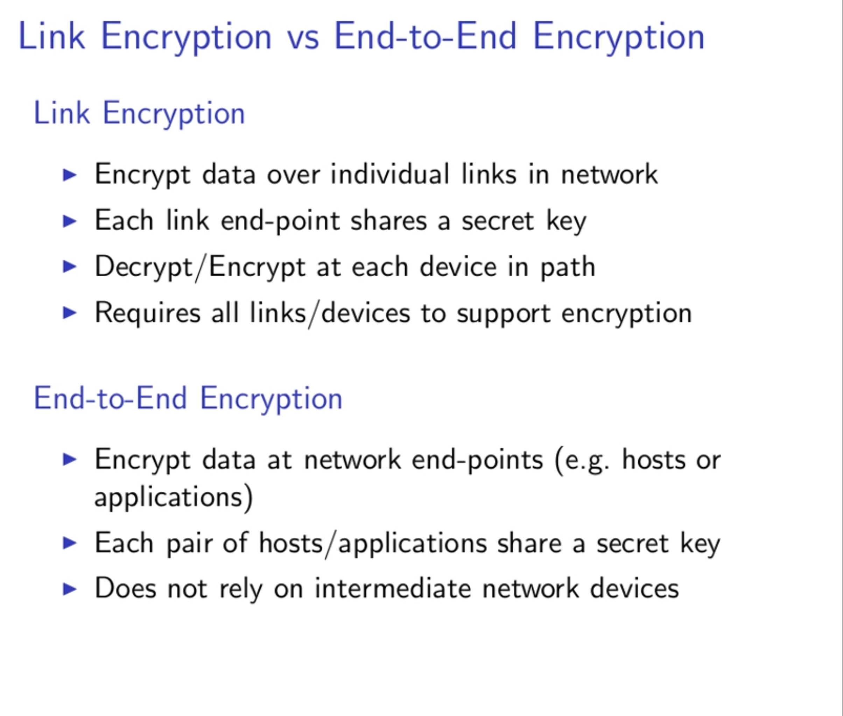

Slide 6
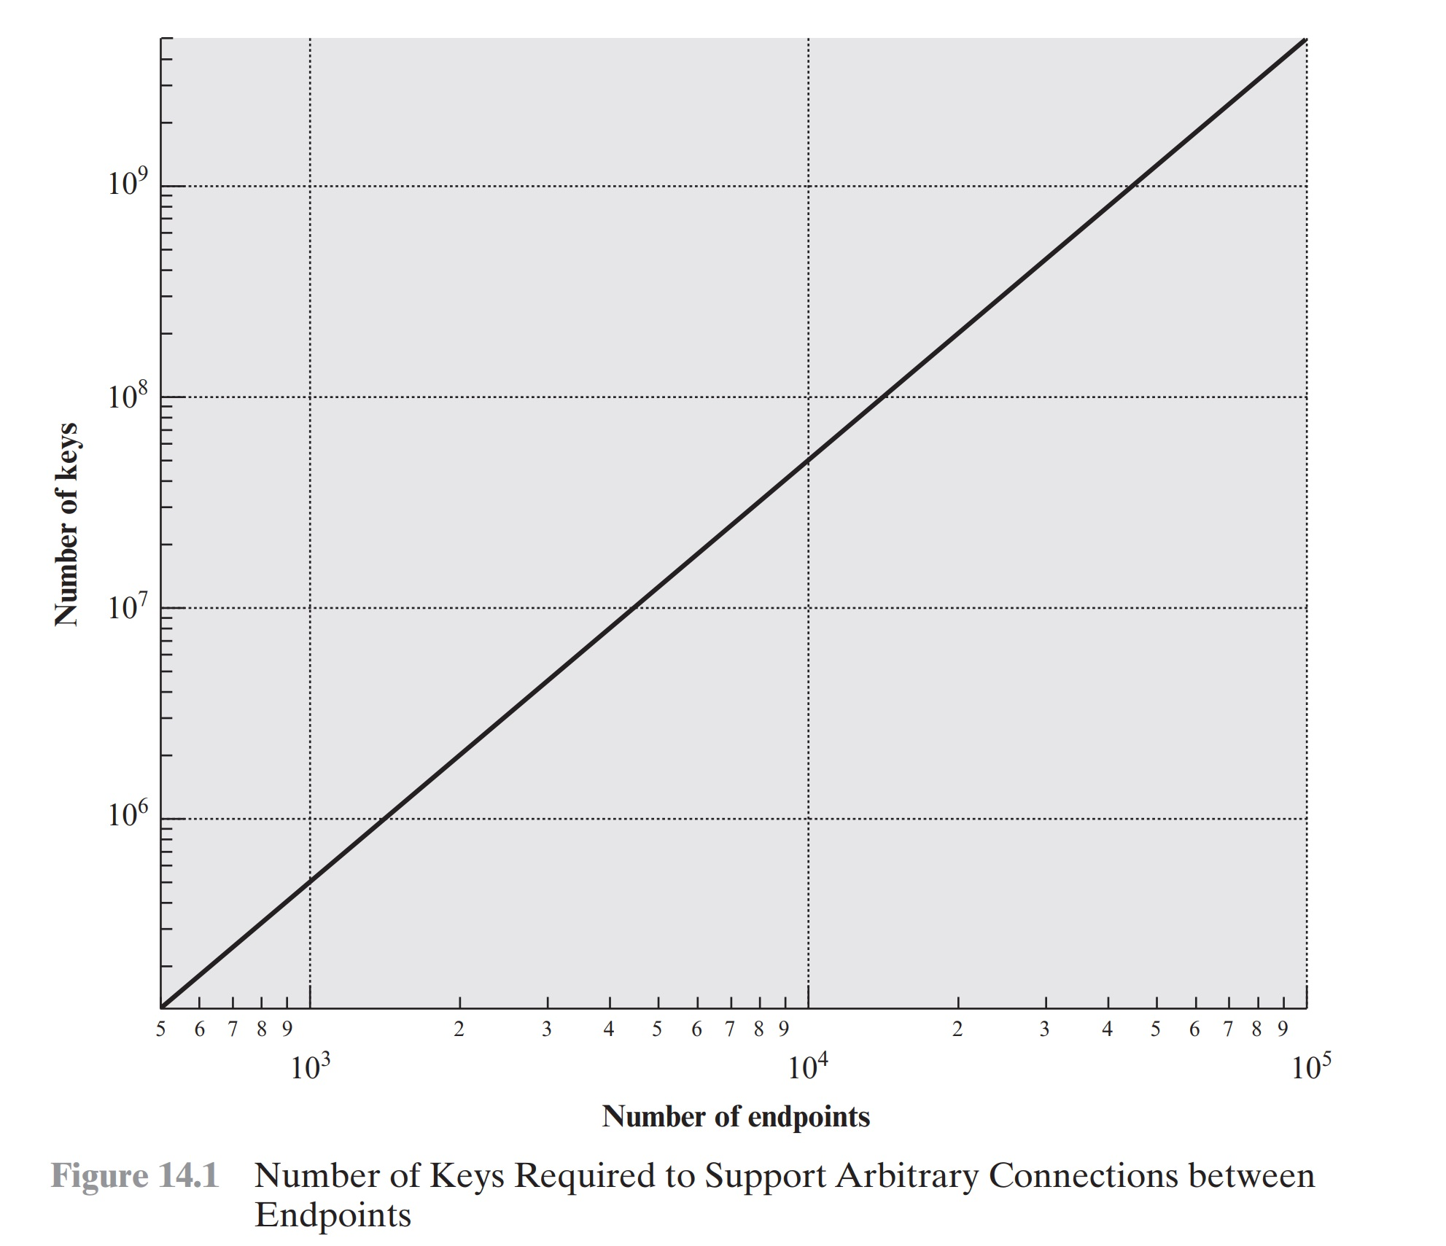

Slide 7
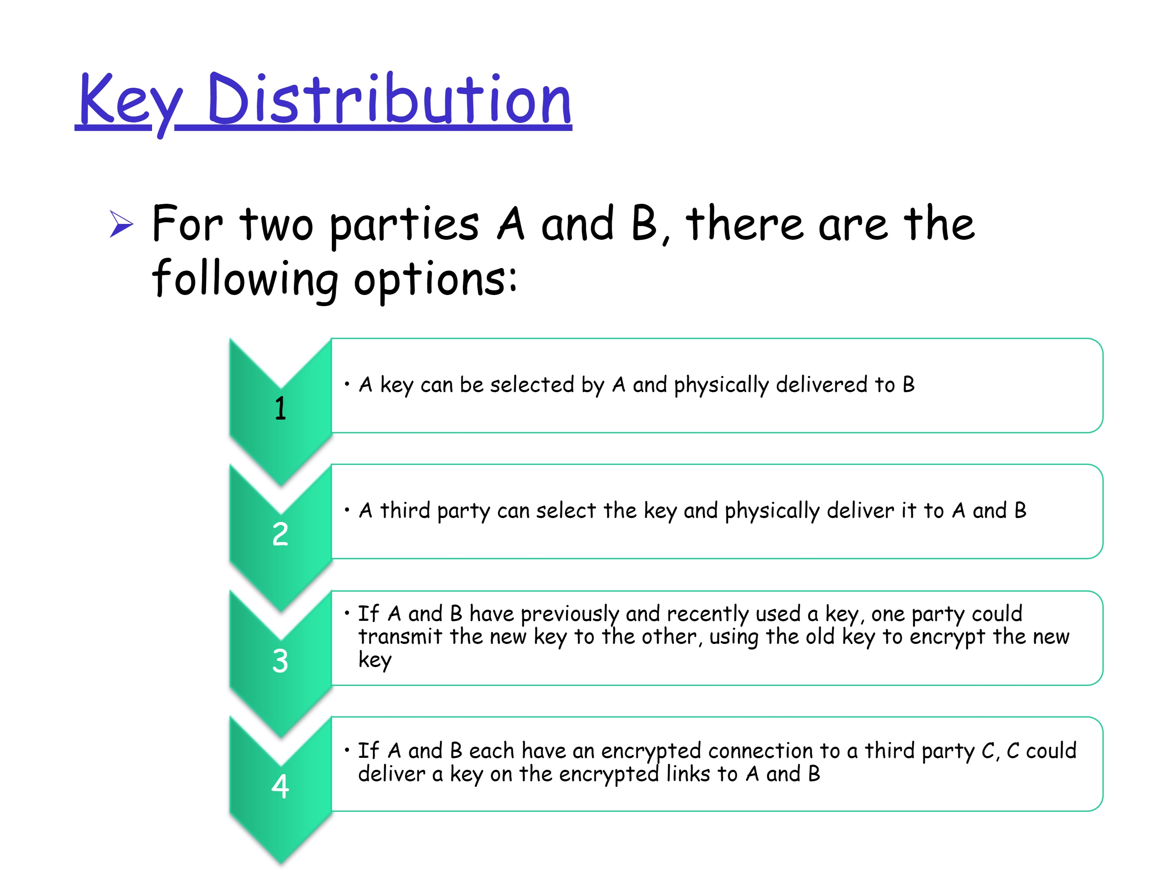

Slide 8
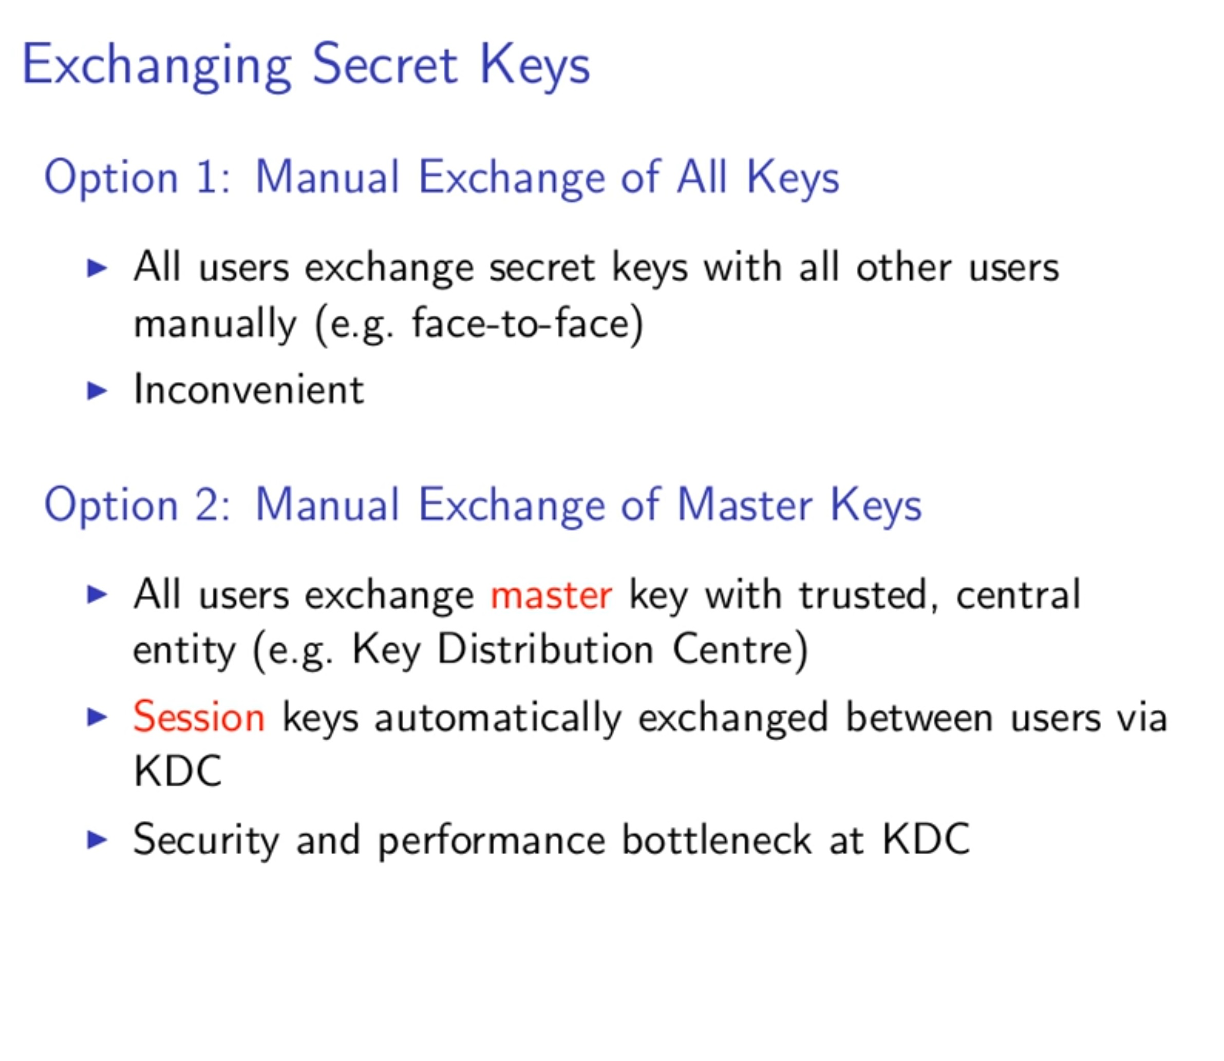

Slide 9
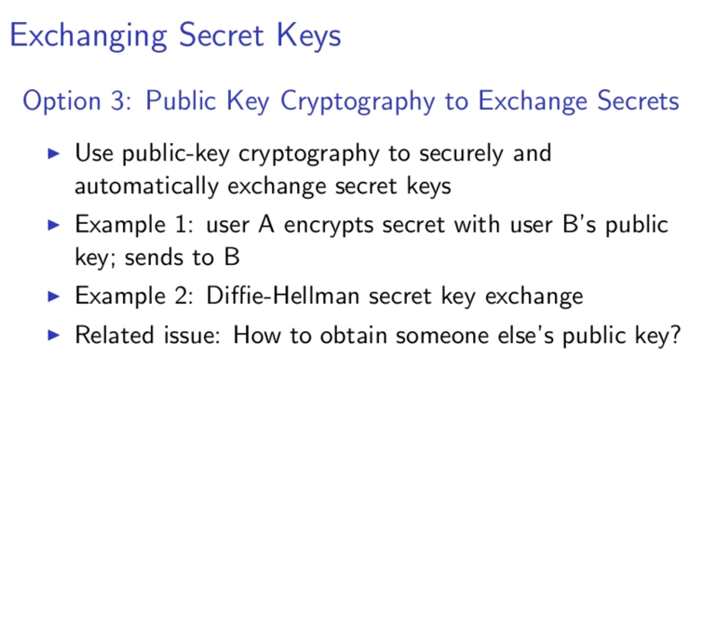

Slide 10
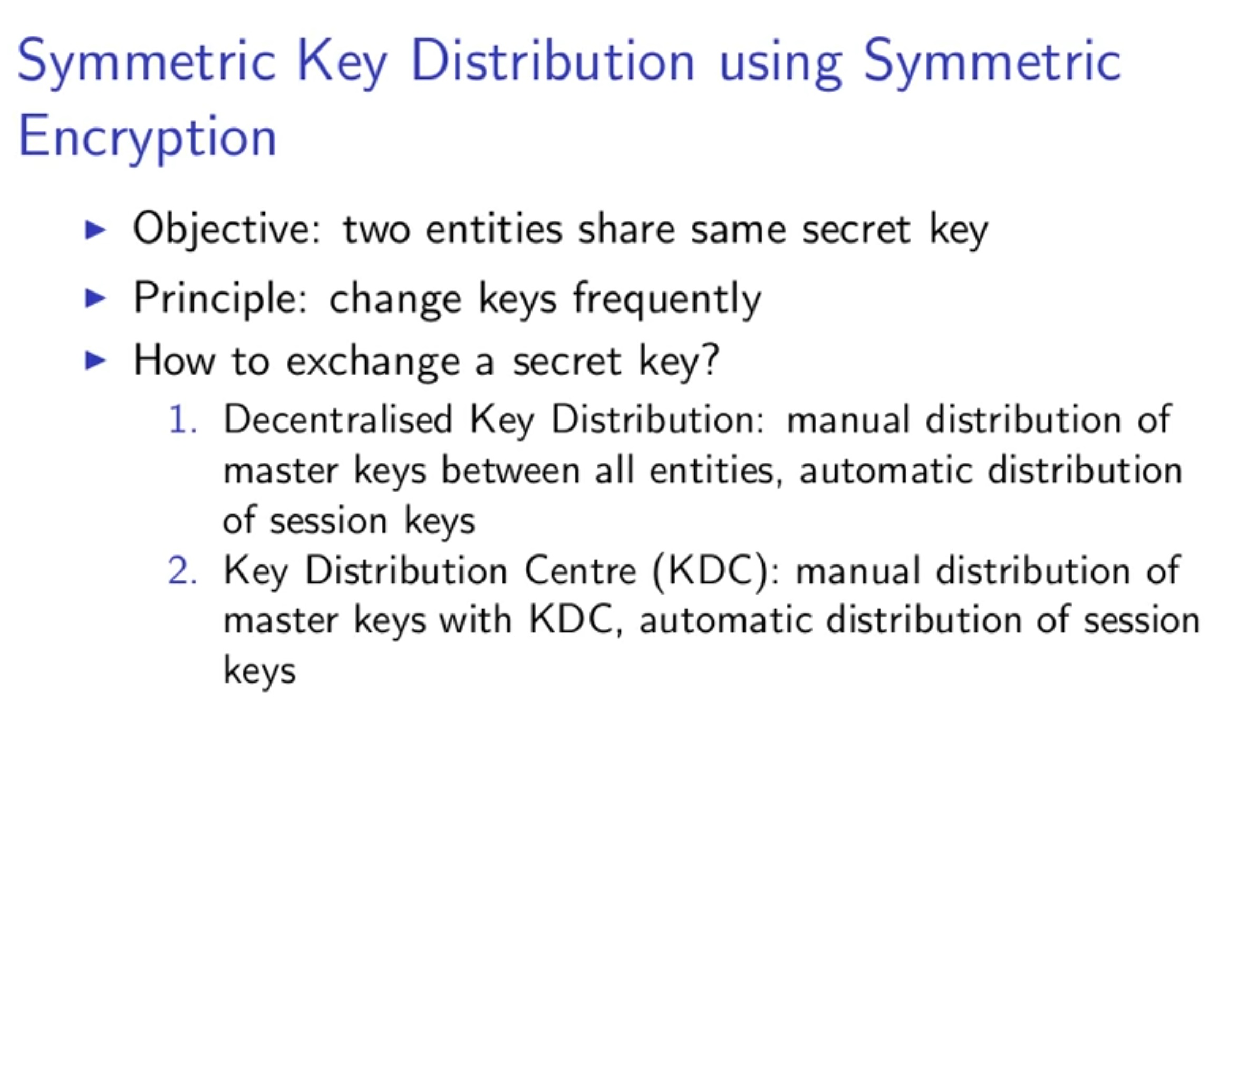

Slide 11
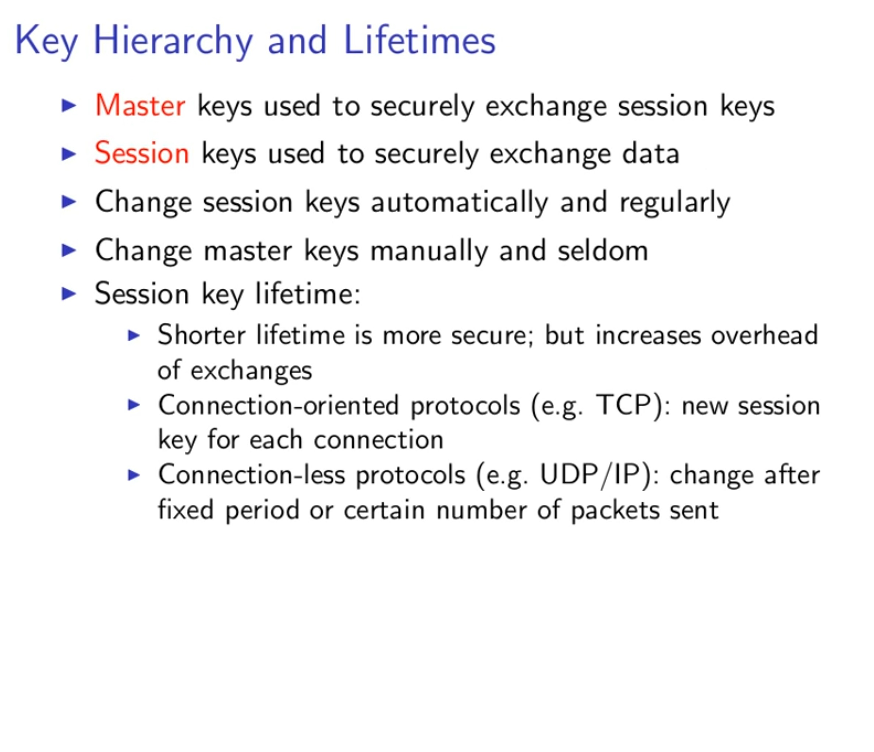

Slide 12
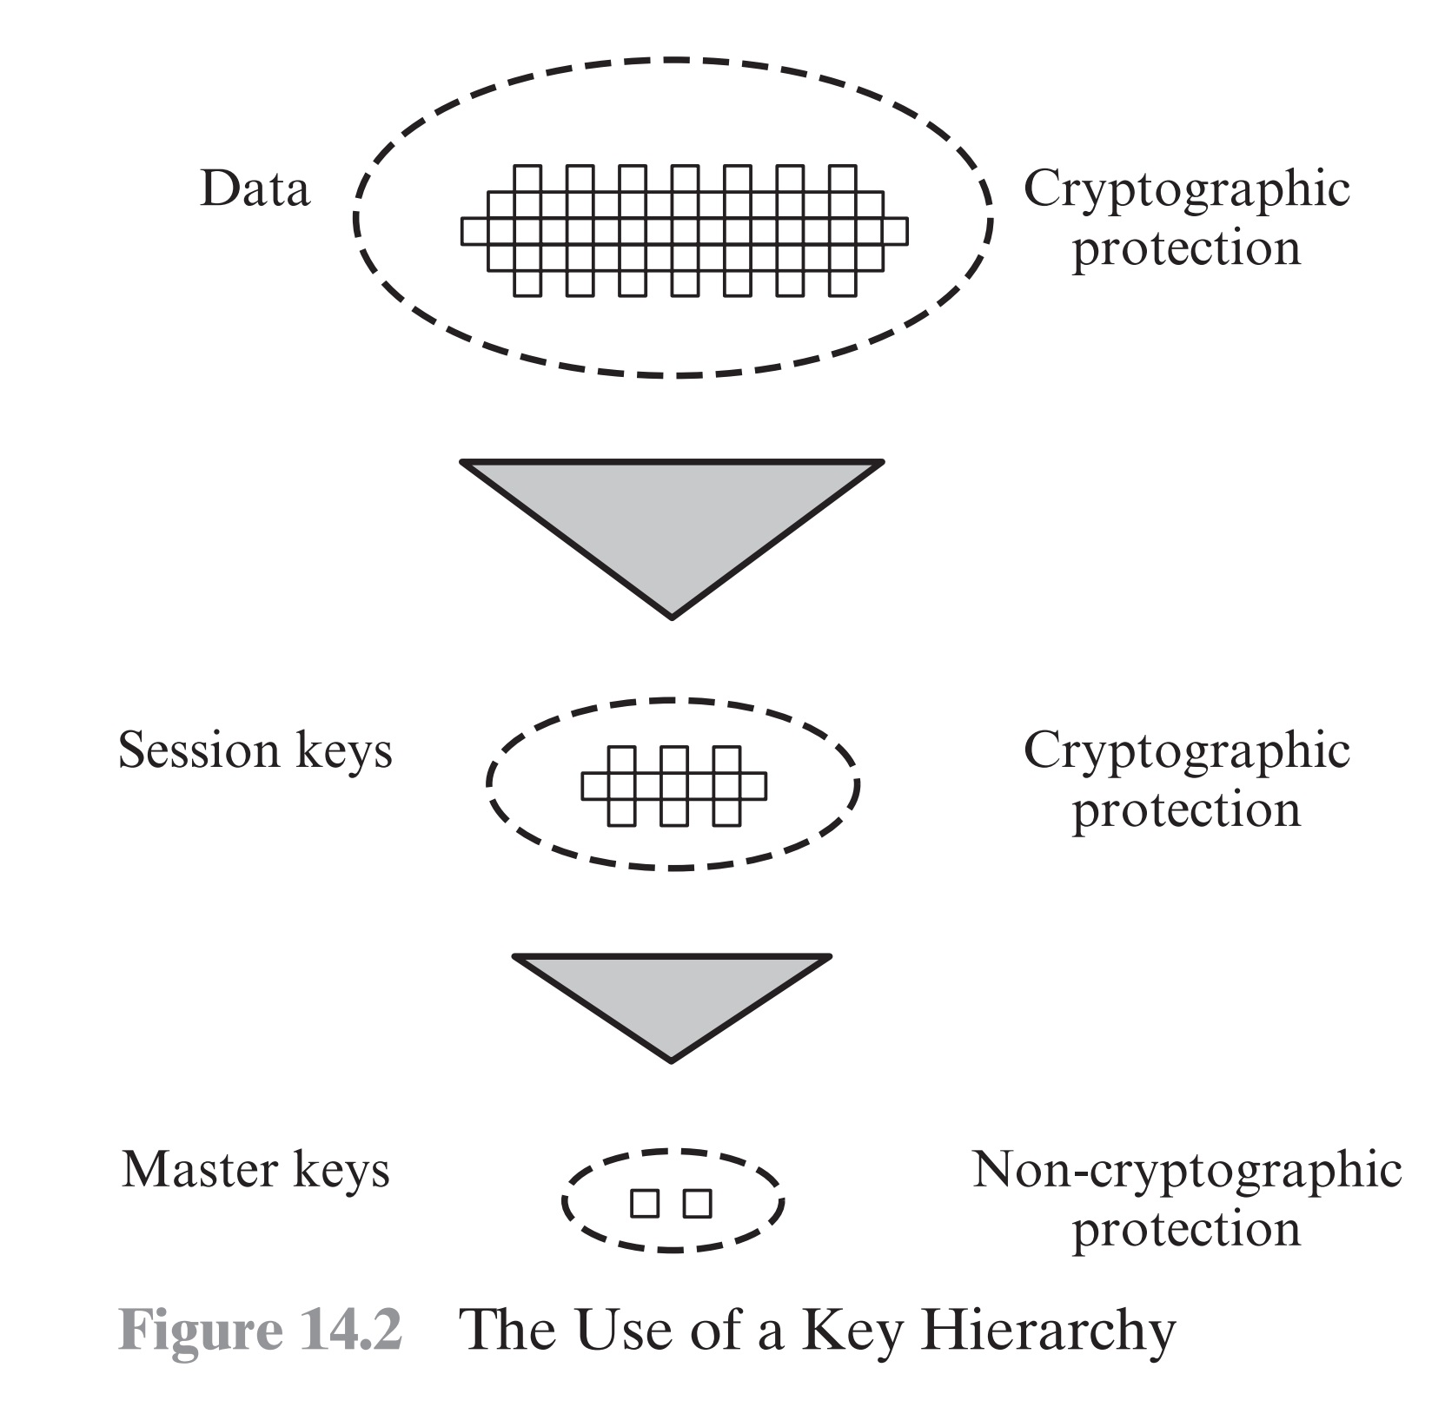

Slide 13
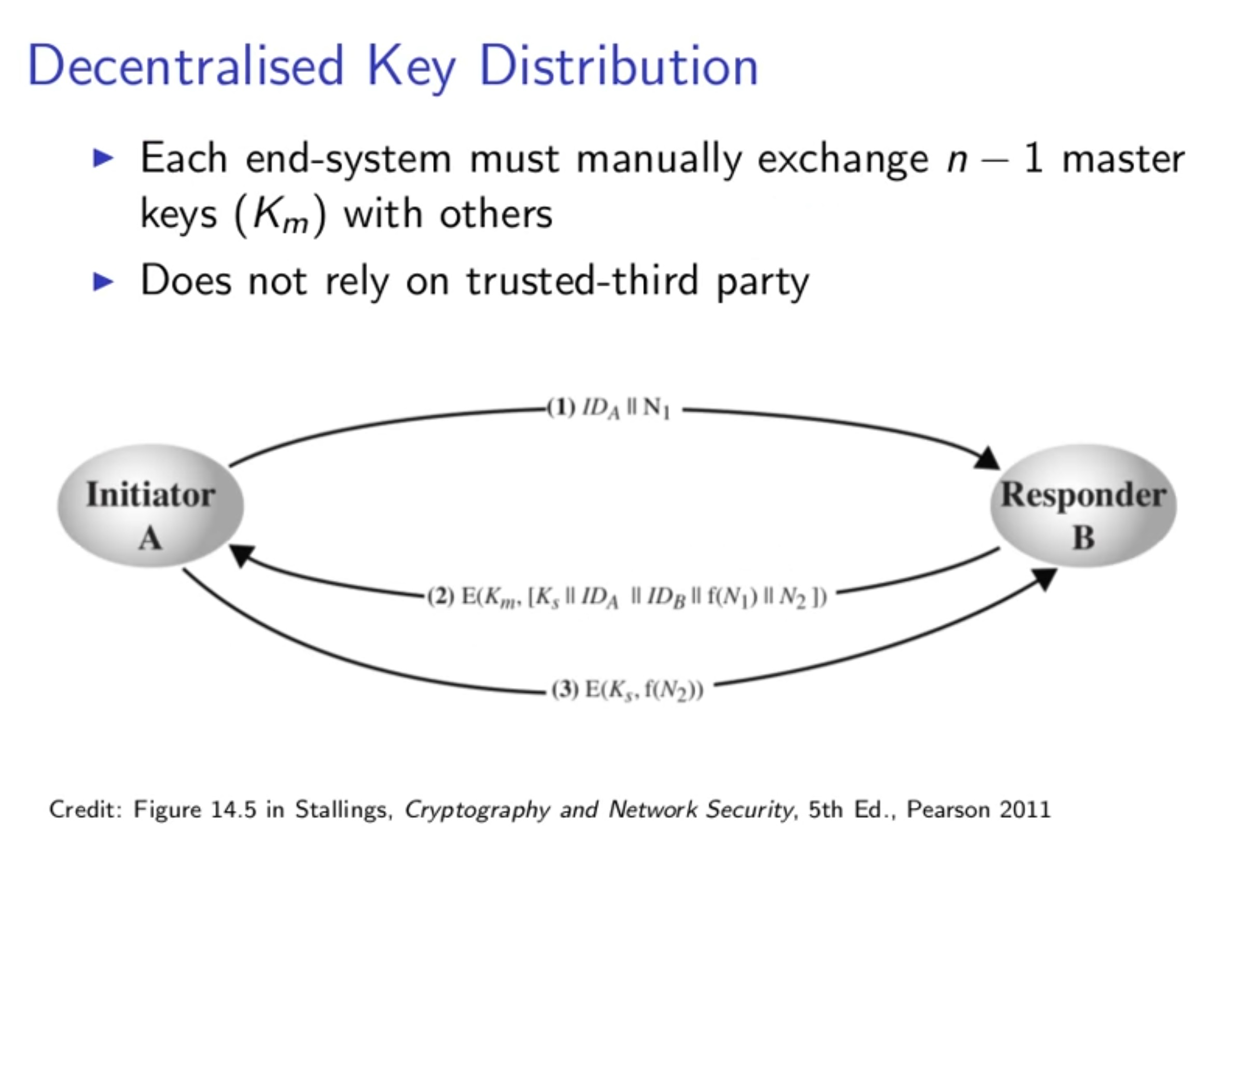

Slide 14
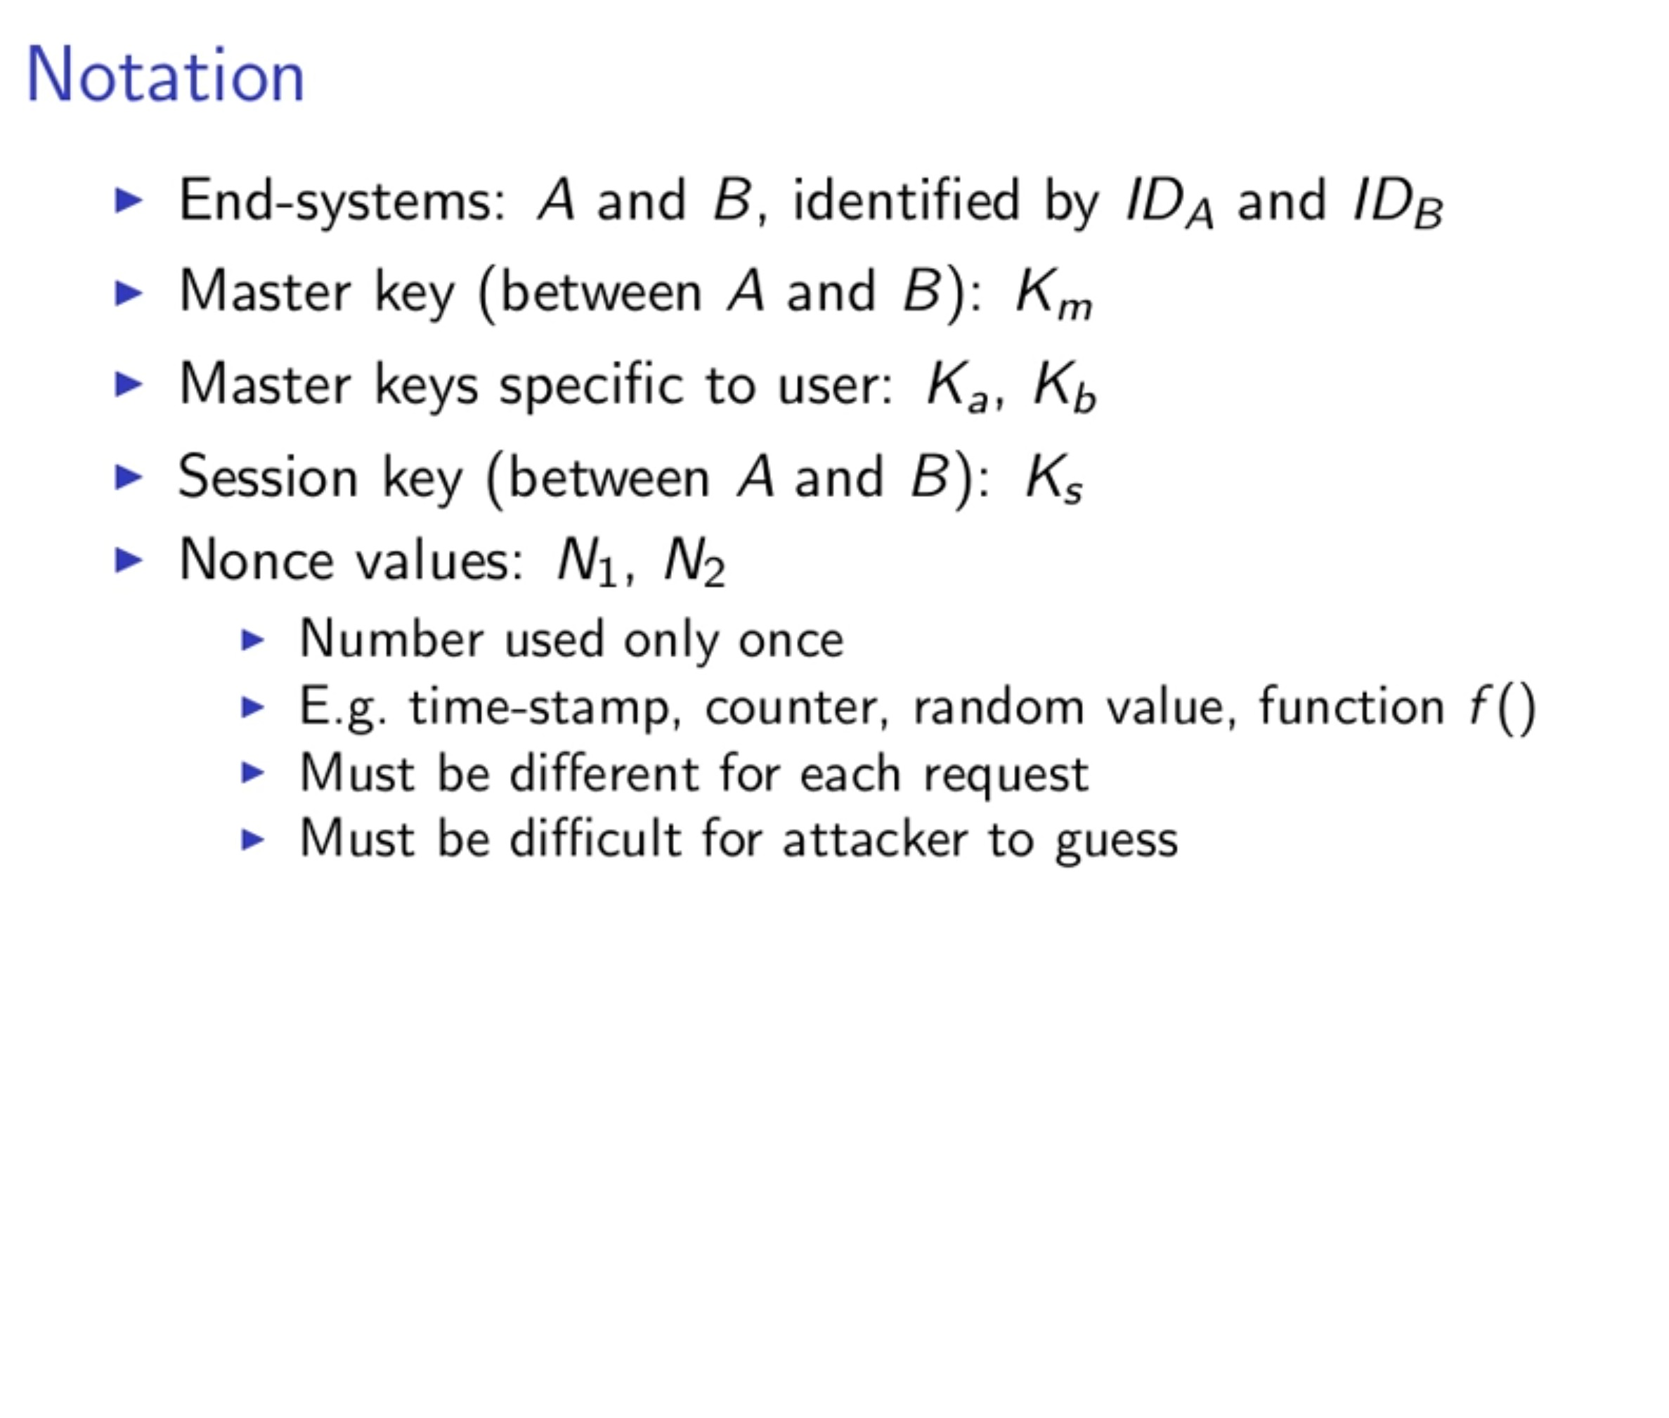

Slide 15
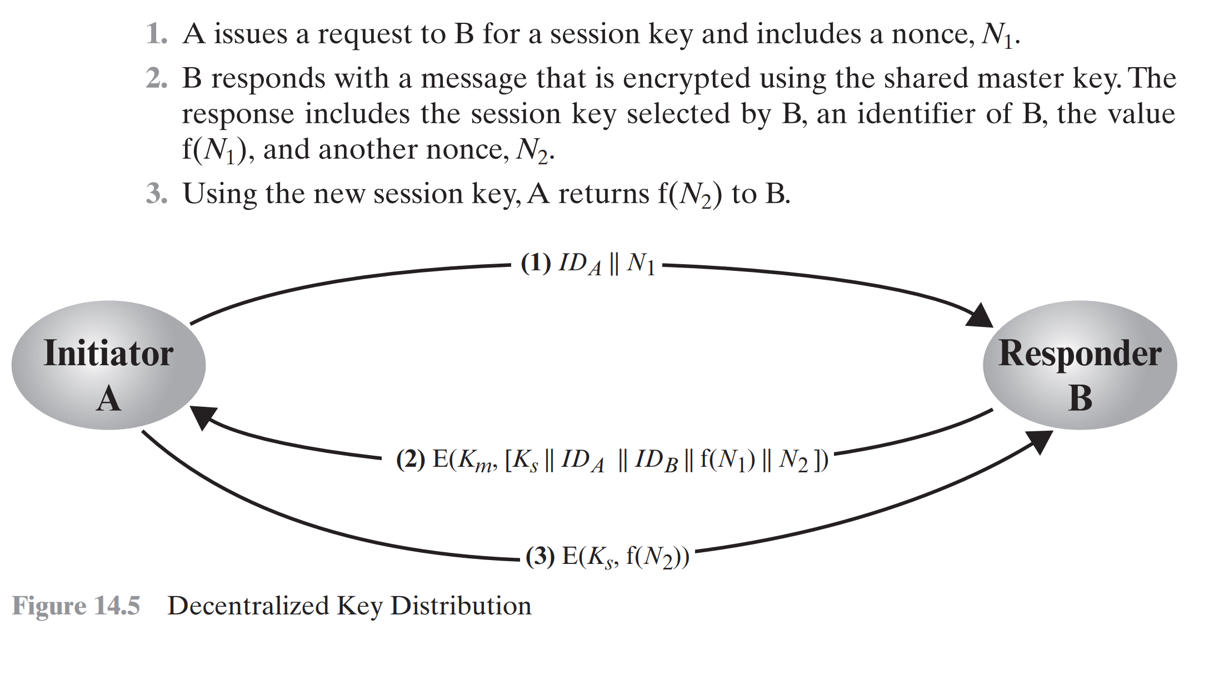

Slide 16
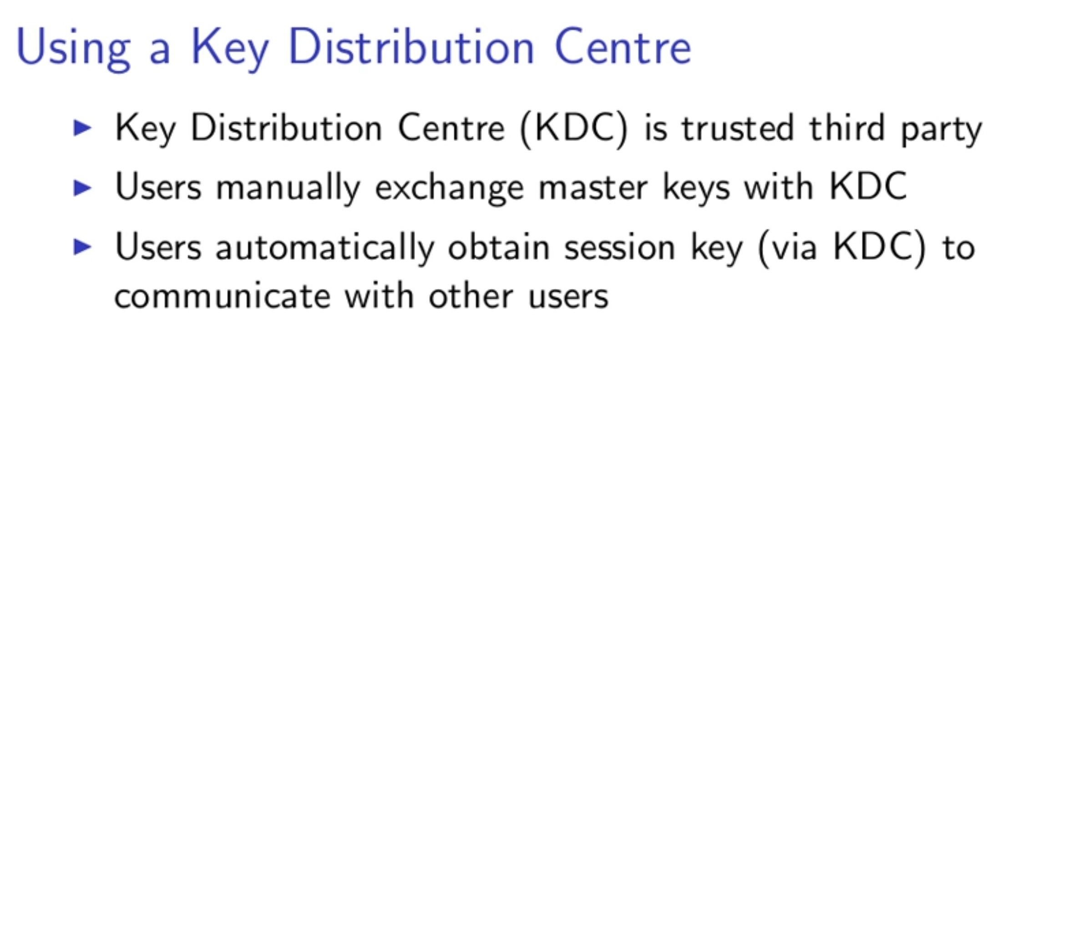
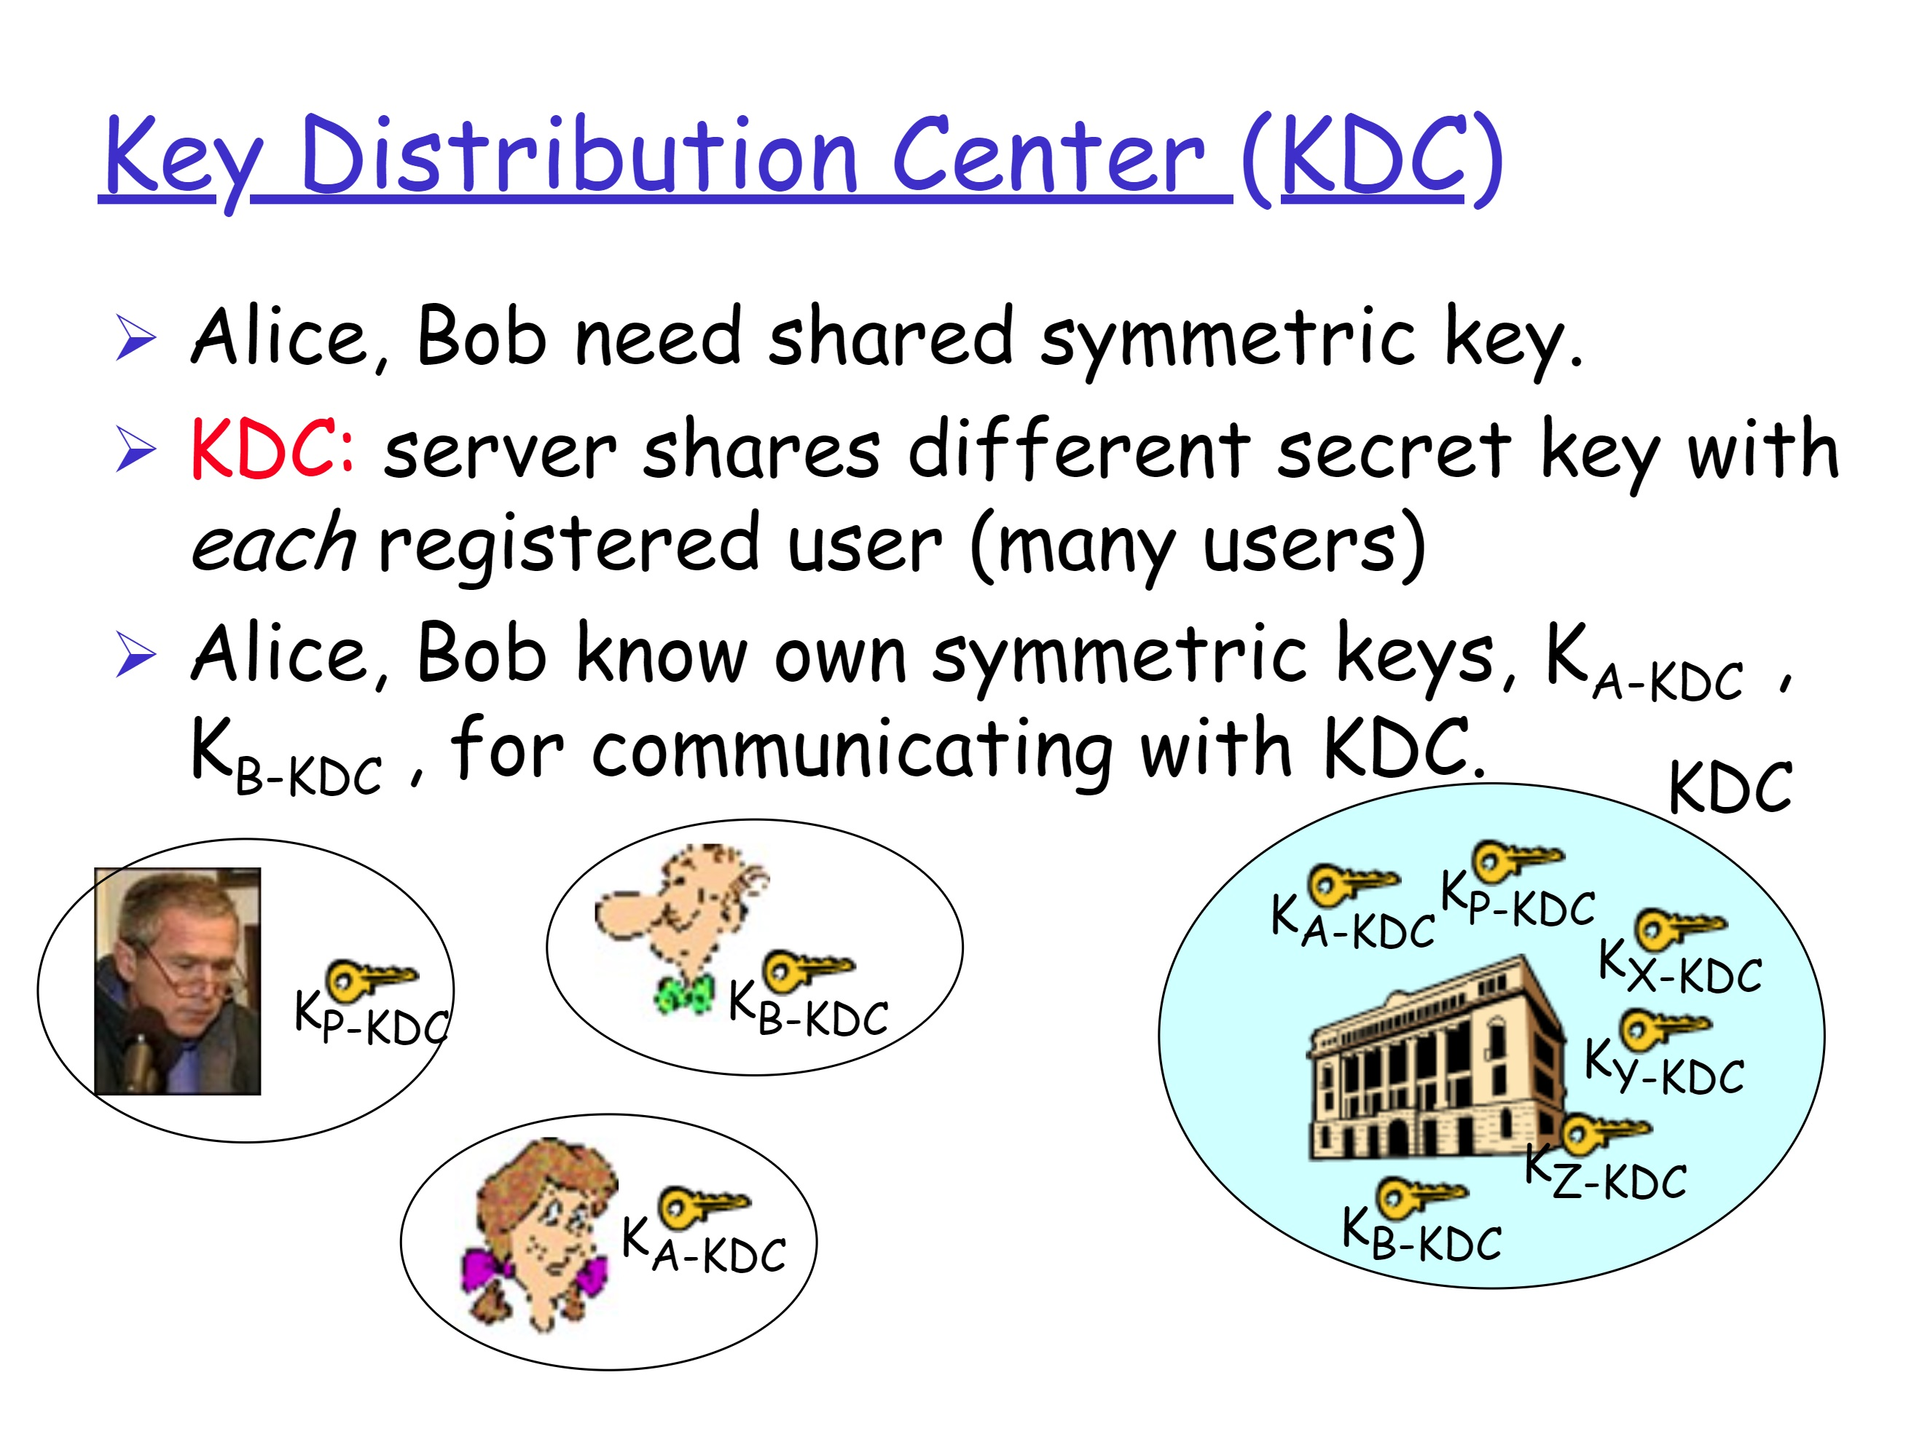

Slide 17
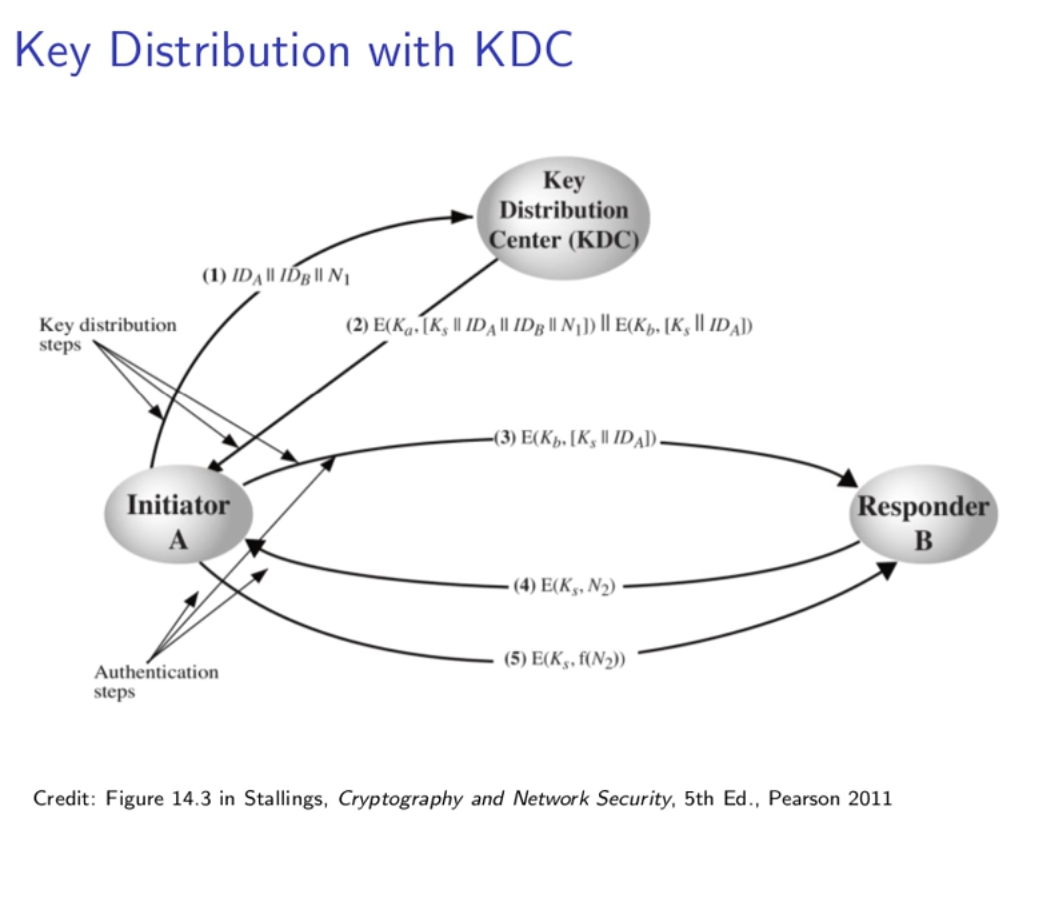

Slide 18
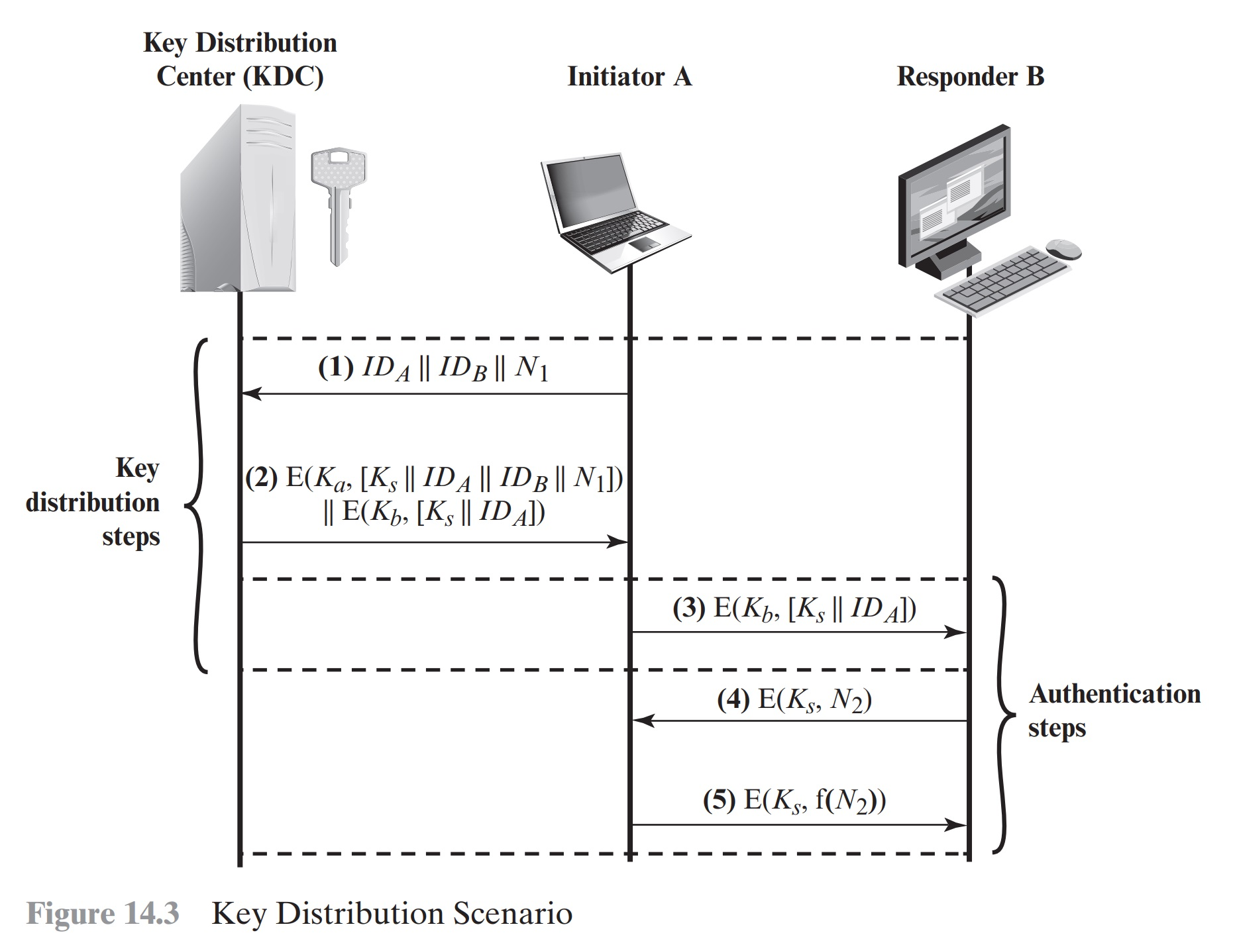

Slide 19
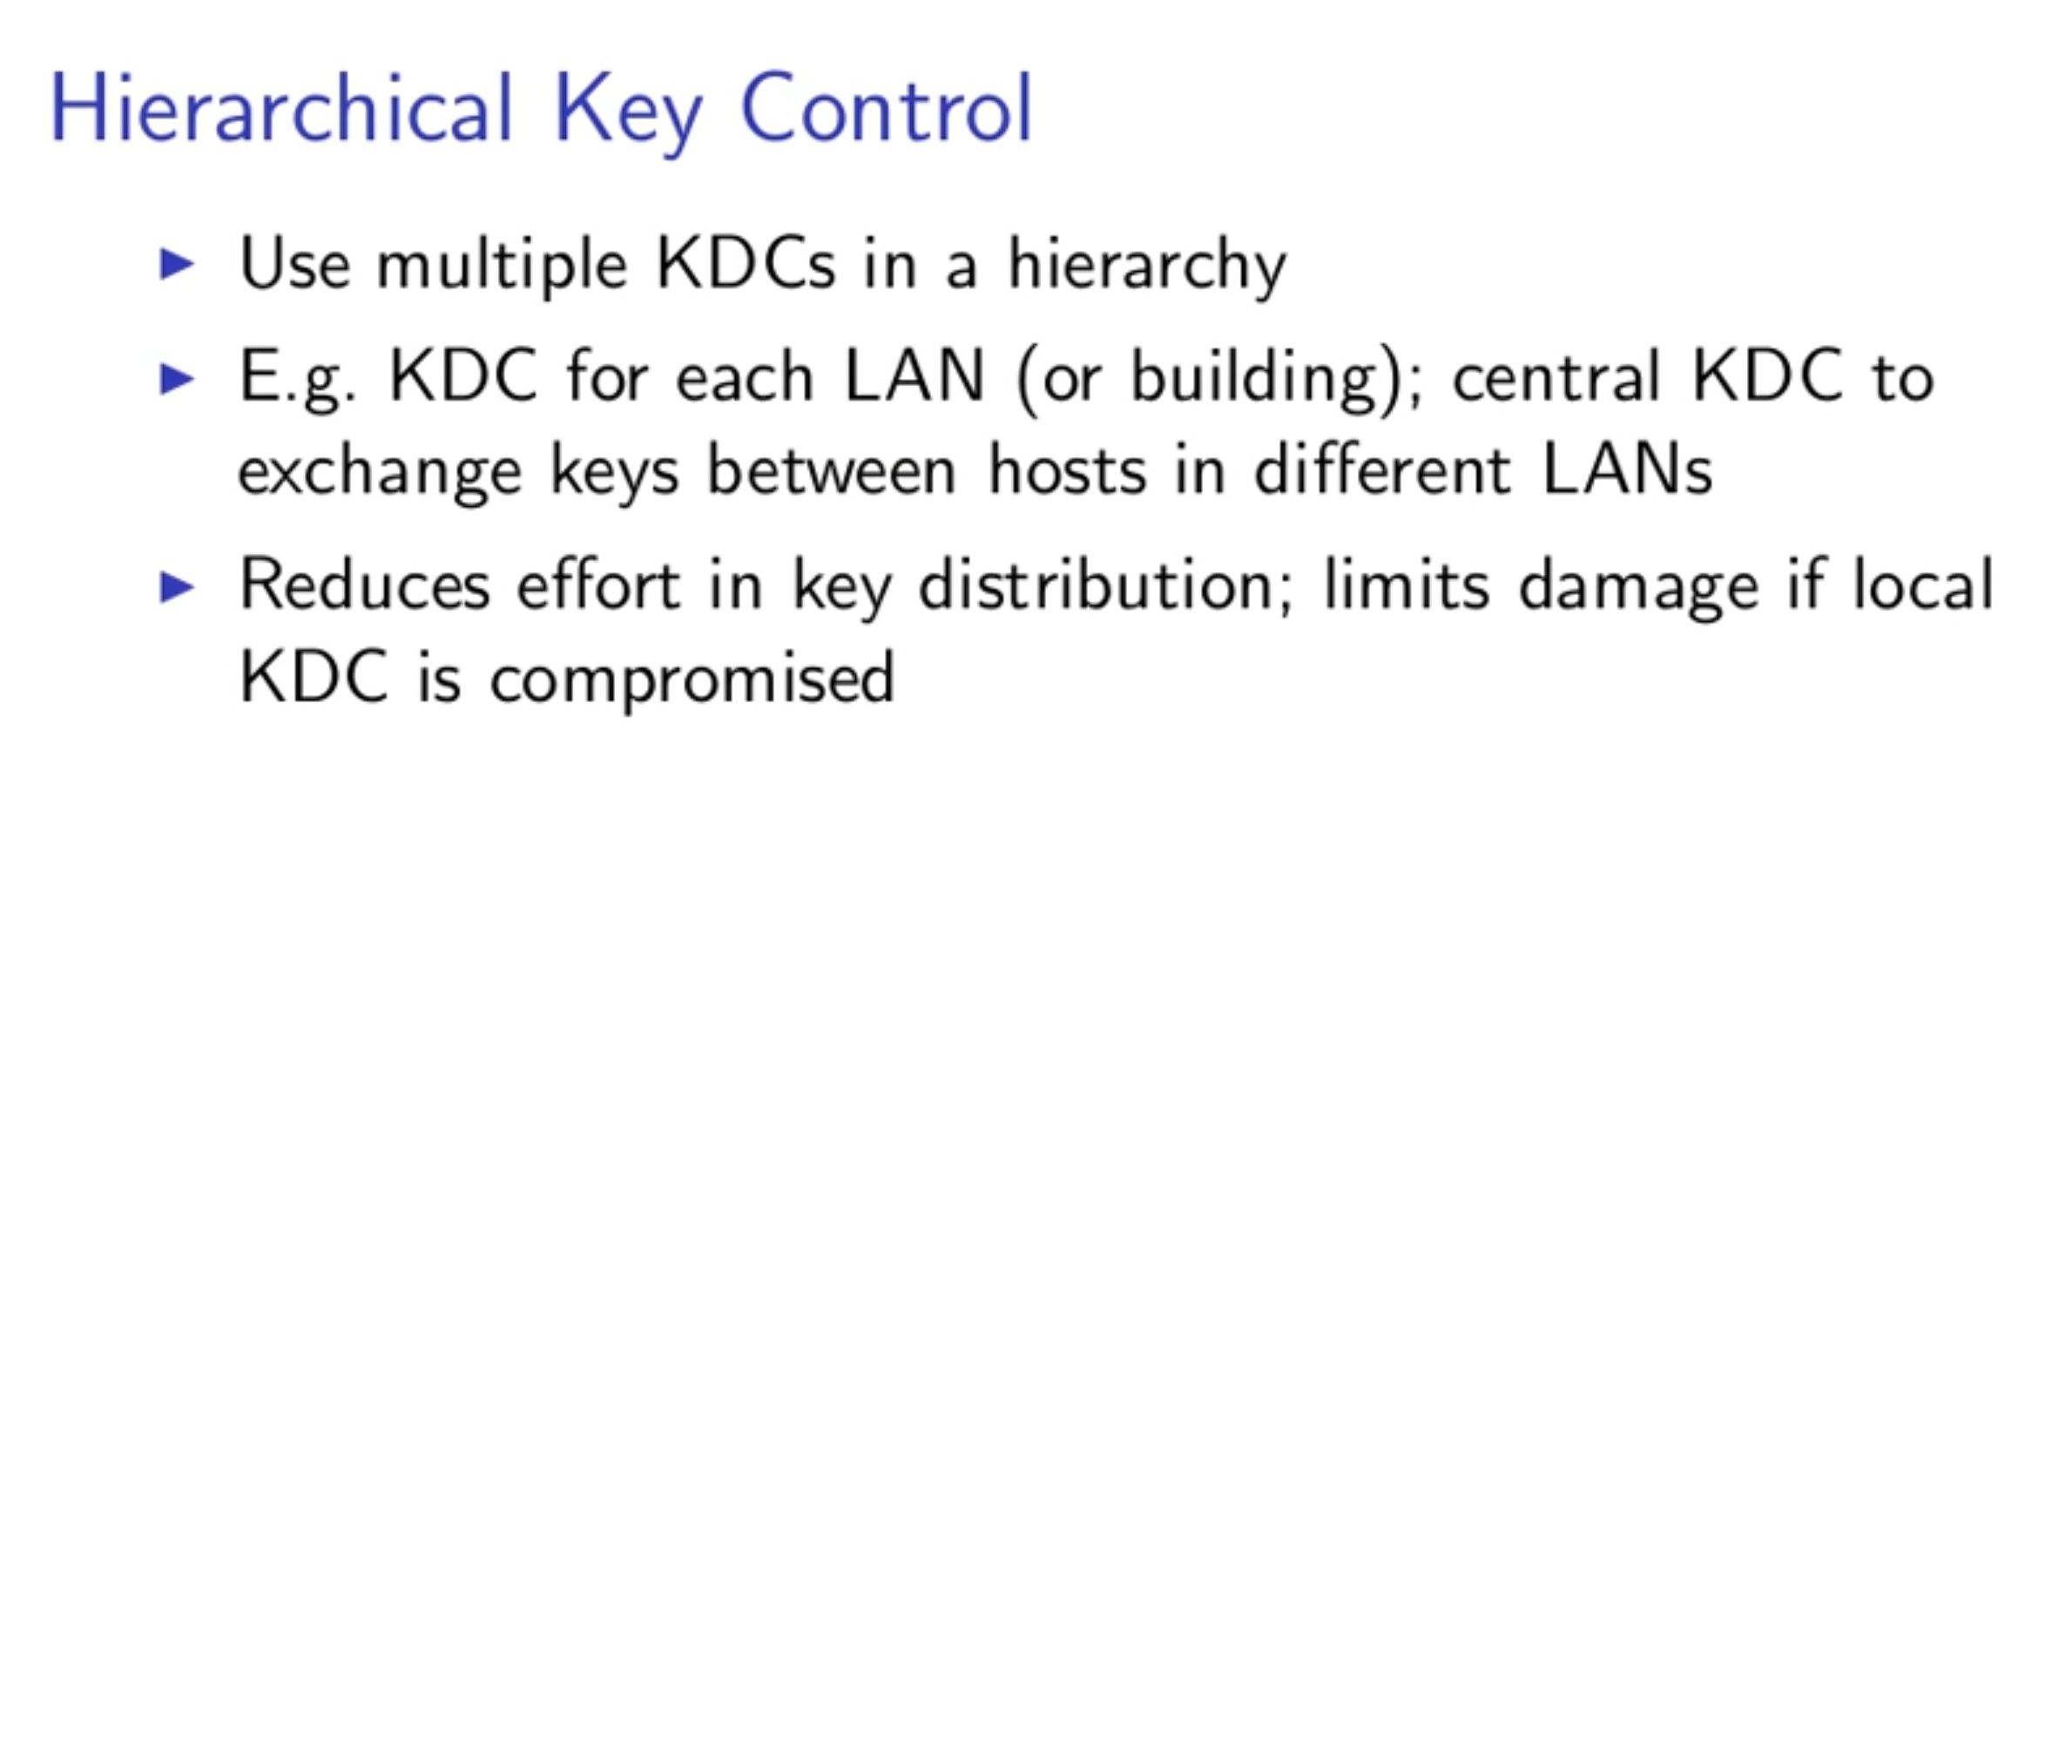
Example:
There can be local KDCs, each responsible for a small domain of the overall internetwork, such as a single LAN or a single building.
For communication among entities within the same local domain, the local KDC is responsible for key distribution.
If two entities in different domains desire a shared key, then the corresponding local KDCs can communicate through a global KDC.
In this case, any one of the three KDCs involved can actually select the key.
The hierarchical concept can be extended to three or even more layers, depending on the size of the user population and the geographic scope of the internetwork.

Slide 20
Session Key Lifetime
The more frequently session keys are exchanged, the more secure they are
The distribution of session keys delays the start of any exchange and places a burden on network capacity.
For connection-oriented protocols, one obvious choice is to use the same session key for the length of time that the connection is open, using a new session key for each new session.
If a logical connection has a very long lifetime, then it would be prudent to change the session key periodically, perhaps every time the PDU (protocol data unit) sequence number cycles.
For a connectionless protocol, such as a transaction-oriented protocol, there is no explicit connection initiation or termination. Thus, it is not obvious how often one needs to change the session key. The most secure approach is to use a new session key for each exchange.

Slide 21
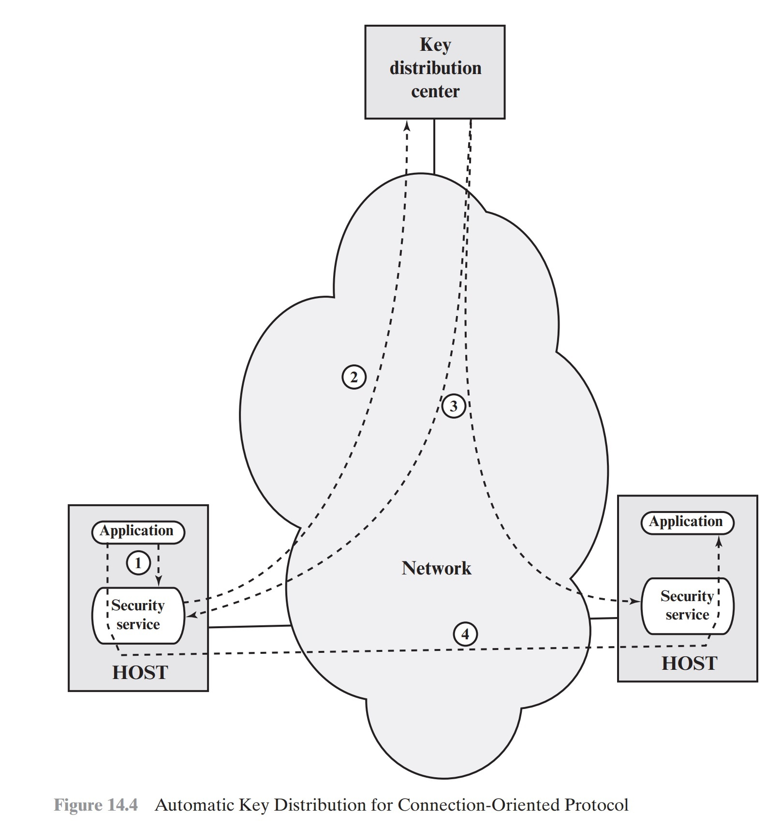
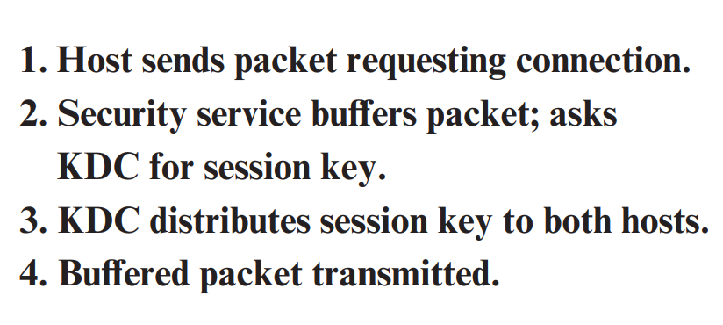
A Transparent Key Control Scheme

Slide 22
A Transparent Key Control Scheme
The scheme (Figure 14.4) is useful for providing end-to-end encryption at a network or transport level in a way that is transparent to the end users.
The approach assumes that communication makes use of a connection- oriented end-to-end protocol, such as TCP.
The noteworthy element of this approach is a session security module (SSM),
SSM may consist of functionality at one protocol layer, that performs end-to-end encryption and obtains session keys on behalf of its host or terminal.

Slide 23
Controlling Key Usage
The concept of a key hierarchy and the use of automated key distribution techniques greatly reduce the number of keys that must be manually managed and distributed.
It also may be desirable to impose some control on the way in which automatically distributed keys are used.
For example, in addition to separating master keys from session keys, we may wish to define different types of session keys on the basis of use, such as
Data-encrypting key, for general communication across a network
PIN-encrypting key, for personal identification numbers (PINs) used in electronic funds transfer and point-of-sale applications
File-encrypting key, for encrypting files stored in publicly accessible locations

Slide 24
Controlling Key Usage - tag
It may be desirable to institute controls in systems that limit the ways in which keys are used, based on characteristics associated with those keys.
If a master key is treated as a session key, it may be possible for an unauthorized application to obtain plaintext of session keys encrypted with that master key.
One simple plan is to use 8bit tag (limited bits) with DES and makes use of the extra 8 bits in each 64-bit DES key. (DES has 56 bits keys we used to remove 8bits)
One bit indicates whether the key is a session key or a master key
One bit indicates whether the key can be used for encryption
One bit indicates whether the key can be used for decryption
The remaining bits are spares for future use.

Slide 25
Controlling Key Usage – tag_The drawbacks
The tag length is limited to 8 bits, limiting its flexibility and functionality.
Because the tag is not transmitted in clear form, it can be used only at the point of decryption, limiting the ways in which key use can be controlled.

Slide 26
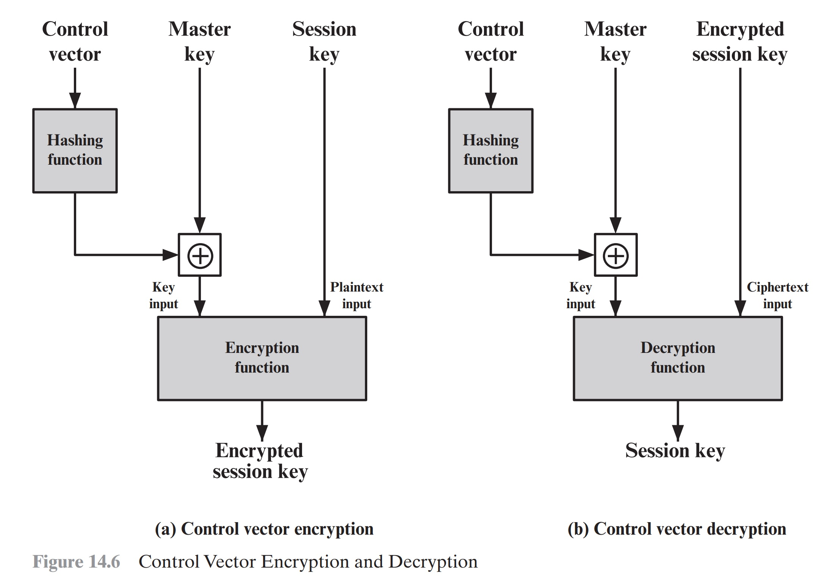
Controlling Key Usage – Control Vector

Slide 27
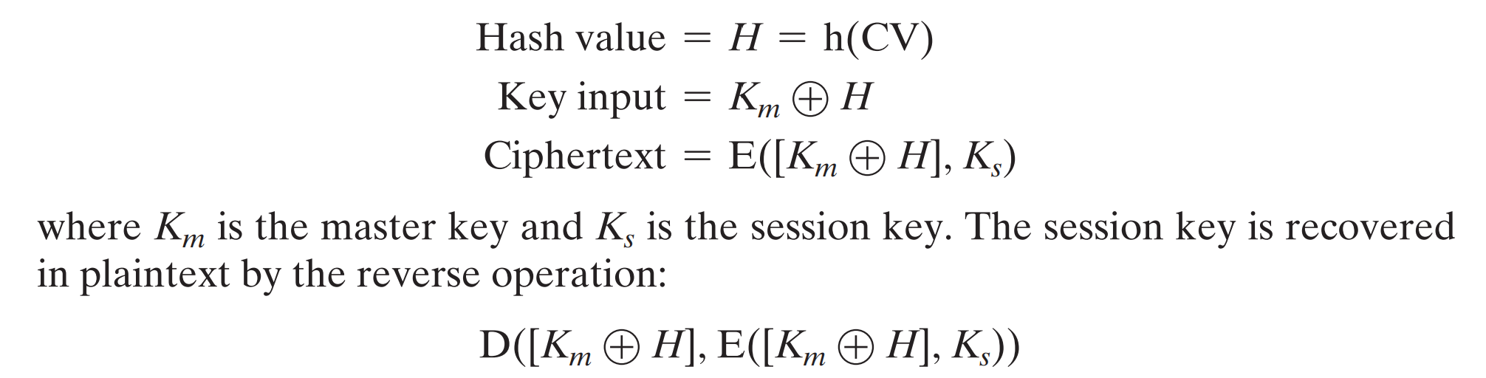
Controlling Key Usage – Control Vector
When a session key is delivered to a user from the KDC, it is accompanied by the control vector in clear form.
The session key can be recovered only by using both the master key that the user shares with the KDC and the control vector.

Slide 28
Controlling Key Usage – Control Vector Advantage
Control Vector (CV) has two advantages over use of an 8-bit tag
First, there is no restriction on length of the control vector, which enables arbitrarily complex controls to be imposed on key use.
Second, the control vector is available in clear form at all stages of operation.

